Slide 1



GLOBAL POWER PLATFORM BOOTCAMP
Organized Globally, Held Locally

Slide 2
Deep Dive: Integrating Power Apps Portals with Microsoft Face API
Jonathan Kovacs

Slide 3
Deep Dive: Integrating Power Apps Portals with Microsoft Face API
Jonathan Kovacs

Slide 4

Jonathan Kovacs
Technical Team Lead
KPMG
20 years of development experience
10 years of xRM Platform / Portals
Power Platform Padawan

Slide 5
Deep Dive: Integrating Power Apps Portals with Microsoft Face API
Agenda
Describe Face API and how it is used.
Demonstrate an example use case.
Explain the technical challenges.
Main Goal: Go deeper than an intro session.

Slide 6
Deep Dive: Integrating Power Apps Portals with Microsoft Face API
Secret Goal: Keep at least 50% of the audience awake until the end!

Slide 7
Session Agenda
So what is this Face API?
Demo!
Limitations of Face API
Pricing
Integration Overview
The Gory Details
Additional Resources
Questions

Slide 8
So what is this Face API?

Slide 9

So what is this Face API?
Part of the Vision category of Microsoft Cognitive Services
Focused on detecting and identifying people’s faces.
Cloud-Native AaaS offering (API as a Service)

Slide 10
How it works
Face API is made up of 5 endpoints
Detect – Detect human faces in an image.
Find Similar – Return similar looking faces from a list
Group – Group faces together by similarity.
Identify – Find the closest matches to a given face.
Verify – Verify whether two faces belong to the same person.

Slide 11
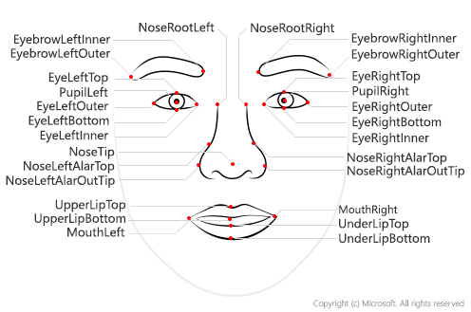
How it works - Detect
Detect human faces in an image.
Takes an image and returns a Face ID*, landmarks and attributes.

Slide 12
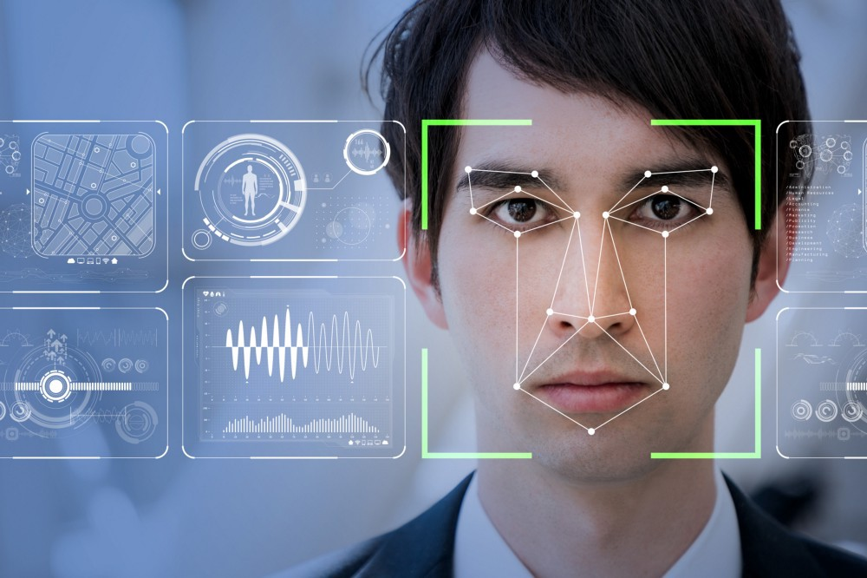
How it works – Face IDs
Face IDs are identifiers for detected faces which expire after 24 hours unless saved to a Face List or Person Group.
"faceId": "c5c24a82-6845-4031-9d5d-978df9175426",

Slide 13
How it works – Find Similiar
Takes a Face ID and an array of Face IDs or a face list and returns a list of faces similar to the given face.
Finds a known person’s other photos (faceIds.

Slide 14
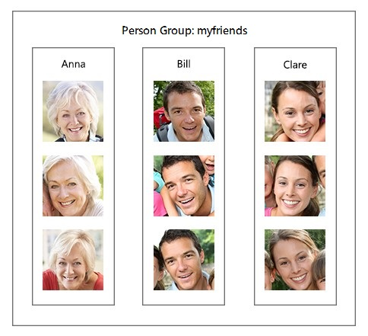
How it works - Group
Takes a list of Face IDs and groups them together by similarity.

Slide 15

How it works - Identify
Given a FaceID and a Person Group, attempts to identify the Person.

Slide 16
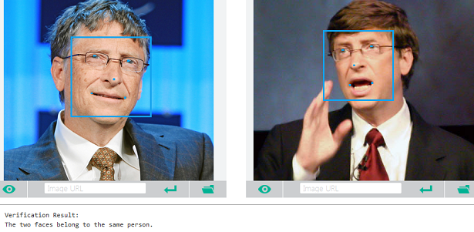
How it works - Verify
Verify whether two faces belong to the same person, or whether a given face belongs to a specific person.

Slide 17
How it works
Face API is made up of 5 endpoints
Detect – Detect human faces in an image.
Find Similar – Return similar looking faces from a list
Group – Group faces together by similarity.
Identify – Find the closest matches to a given face.
Verify – Verify whether two faces belong to the same person.

Slide 18
BC Housing Demo

Slide 19
Limitations of Face API

Slide 20
Limitations of Face API - Detect
Can detect up to 100 faces / photo.
Minimum detectable face size is 36x36 pixels in 1920x1080 image.
Microsoft recommends faces that are: frontal, clear and with a minimum size of 200x200px. (100px between the eyes)
Maximum image size is 6MB
Only JPEG, PNG, GIF and BMP supported. (Sorry! No WebP)

Slide 21
Limitations of Face API - Identify
Can identify up to 10 faces per request.
Each person in a group can have up to 248 stored faces.
Microsoft recommends faces that are: frontal, clear and with a minimum size of 200x200px. (100px between the eyes)

Slide 22
Pricing

Slide 23
Pricing
* Transaction limit only applies to web endpoint
 | Free | Standard
Deployment | Web/Container | Web/Container
Transactions* | 20/minute | 10/second
Price | FREE! | $1.28 per 1,000 transactions (up to 1M, price drops in bulk) Face Storage: $0.013/1000 faces/month

Slide 24

Container Deployment (Preview)
Microsoft has created a Linux-based Docker container which may be deployed locally.
Removes Transaction limits, but pricing is unchanged.

Slide 25
Integration Overview

Slide 26
Integration Overview
Implementation uses a combination of a Logic App and Azure Functions; no Power Automate. ☹ (There are reasons!)
Two scenarios:
Add Person Face
Identifying faces from photos

Slide 27
Why Not Flow Power Automate?
Preview connector for Face API exists but is very limited.
No connectors for image manipulation*
*not entirely true.

Slide 28
The Gory Details

Slide 29
Portal Implementation
Housing Demo implementation uses iFrame and directly calls an Azure Function.
iFrame is not strictly necessary. Was used for ease of integration with existing form.

Slide 30
Portal Implementation

Slide 31
Dynamics Implementation
Triggers a Logic App on creation of a Note on a Contact with an image attachment.
Used to add new faces to the Person Group.
Would be better to do this in the portal as well!

Slide 32
Dynamics Implementation

Slide 33
Software code slide
This slide layout uses Consolas, a monotype font which is ideal for showing software code.

Slide 34
Additional Resources

Slide 35
Additional Resources
Face API documentation
https://westus.dev.cognitive.microsoft.com/docs/services/563879b61984550e40cbbe8d/operations/563879b61984550f30395236
Real-time Face Recognition with Microsoft Cognitive Services
https://www.youtube.com/watch?v=KCSyRO0KotA
Face API (Preview) connector for Power Automate
https://docs.microsoft.com/en-us/connectors/faceapi/

Slide 36
Any Questions?

Slide 37

Please fill out the survey! & Win Swags!!
https://www.powerplatformbootcamp.com/survey

Slide 38
Thank You For Attending

